Slide 1
Let’s Get PHYsical
Link Layer Exhaustion Attacks Against Industrial Wireless Implementations
Blake Johnson
Mandiant
S4x18 – January 16 2018

Slide 2
WirelessHART (IEC 62591) and ISA100.11a
Provide wireless connectivity to field devices in automation networks
Deployment footprints typically unit to facility scale
WirelessHART supports mesh networks explicitly through its protocol stack
ISA100.11a relies on IPv6, not all devices will forward traffic for others
Both rely on the IEEE 802.15.4 standard for PHY
WirelessHART uses the 802.15.4 MAC as well
A Comparison of WirelessHART™ and ISA100.11a - Emerson Process Management 2012
Notes:
Relate to layer 1 and 2 of osi model but don’t dwell, we’re not doing 101

Slide 3
Attack Literature Review
Jake Brodsky and Anthony McConnell
S4 2009
Jamming and Interference Induced Denial of Service Attacks on IEEE 802.15.4 Based Wireless Networks
Traditional RF ”Jamming”
Local transmitter prevents channel acquisition by presenting energy to energy detection phase of 802.15.4 PHY CSMA
Impact is local, would not propagate through networks
Notes:
Carrier sense multiple access

Slide 4
Attack Literature Review
Matt Knight and Marc Newlin
DEF CON 25 (2017)
Characterizing, Contextualizing, and Applying Wireless Attack Methods
Propose “Data Link Layer Channel Reservation Abuse” (Link Layer Exhaustion) DOS
Specific to 802.11
Leverages virtual carrier-sensing by sending an empty frame with the maximum frame duration value
All nodes in range will stall transmission
Difficult to detect compared to traditional noise or power based jamming

Slide 5
Application to Industrial Protocols
WirelessHART
WirelessHART leverages cryptography to provide integrity guarantees over data payloads
It does not use 802.15.4’s frame security mechanisms
Certain frame types don’t contain any application layer data, only mesh network or ‘link-layer’ payloads
This includes advertisement frames, the most commonly observed frames in production WirelessHART networks
Notes:
because 802.15.4-2006 did not support authentication of acknowledgement frames, all frames in a WirelessHART network are marked as unsecured data frames at the 802.15.4 link layer. HART then takes the 802.15.4 header, adds a link-layer type byte (a "DLPDU specifier" per HART), and then runs the same CCM* authentication defined in the 802.15.4 specification on that. So HART link-layer frames are authenticated, but not at the 802.15.4 MAC layer as the DLPDU specifier and MIC are considered 802.15.4 payload.

Slide 6
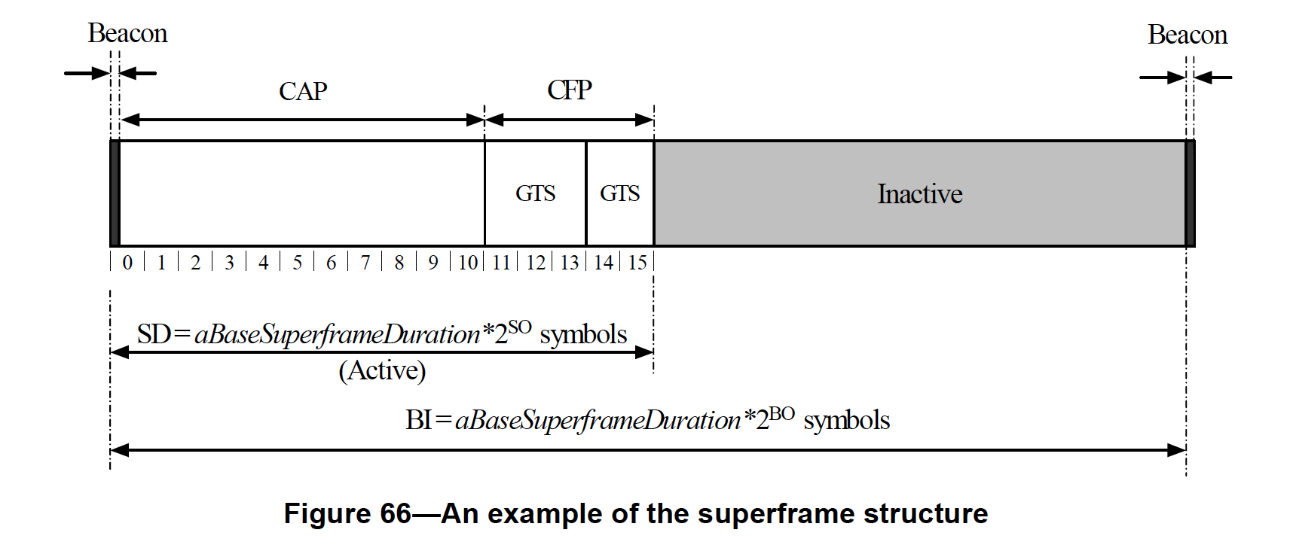
Application to Industrial Protocols
WirelessHART
Mesh consists of two TDMA Global Time Slots (GTS)
Access to first time slot is contentious and controlled via CSMA
Standard specifies all MAC layer ’command frames’ use the CAP
Advertisements are MAC command frames
Notes:
Contentious access period
Carrier sense multiple access

Slide 7
WirelessHART Link Layer Exhaustion
Goal: Combine Brodsky (2009) and Knight (2017) with specifics of the WirelessHART 802.15.4 PHY/MAC
Inject minimum valid WirelessHART advertisement command frames to consume the CAP on an entire mesh

Slide 8
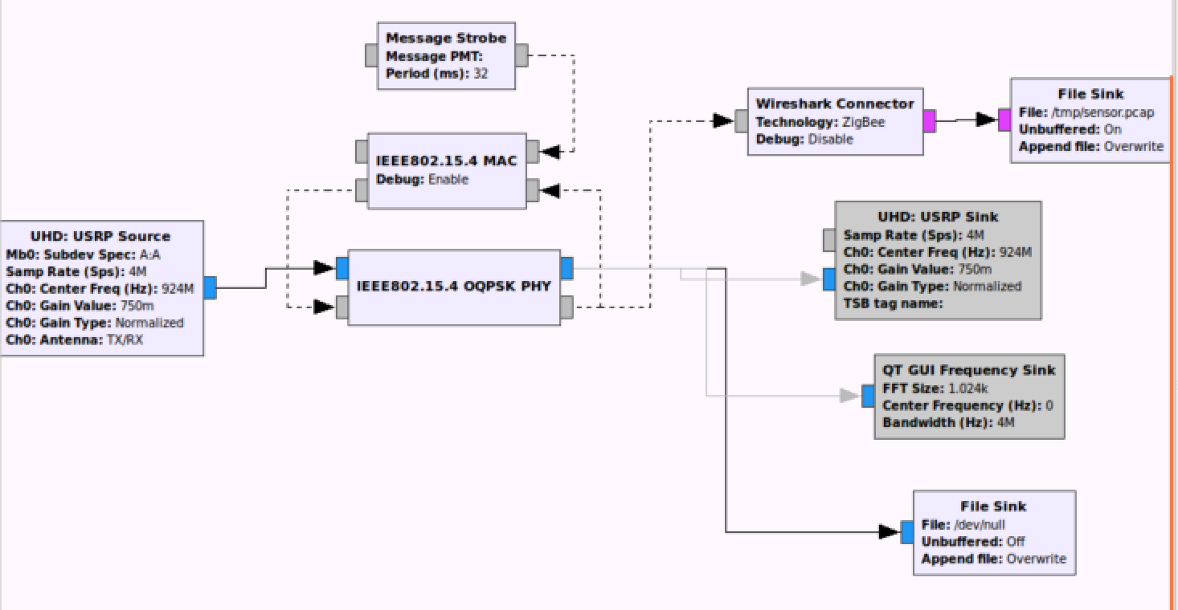
WirelessHART Link Layer Exhaustion
Open source 802.15.4 PHY/MAC implementation
Notes:
Bastian Bloessel

Slide 9
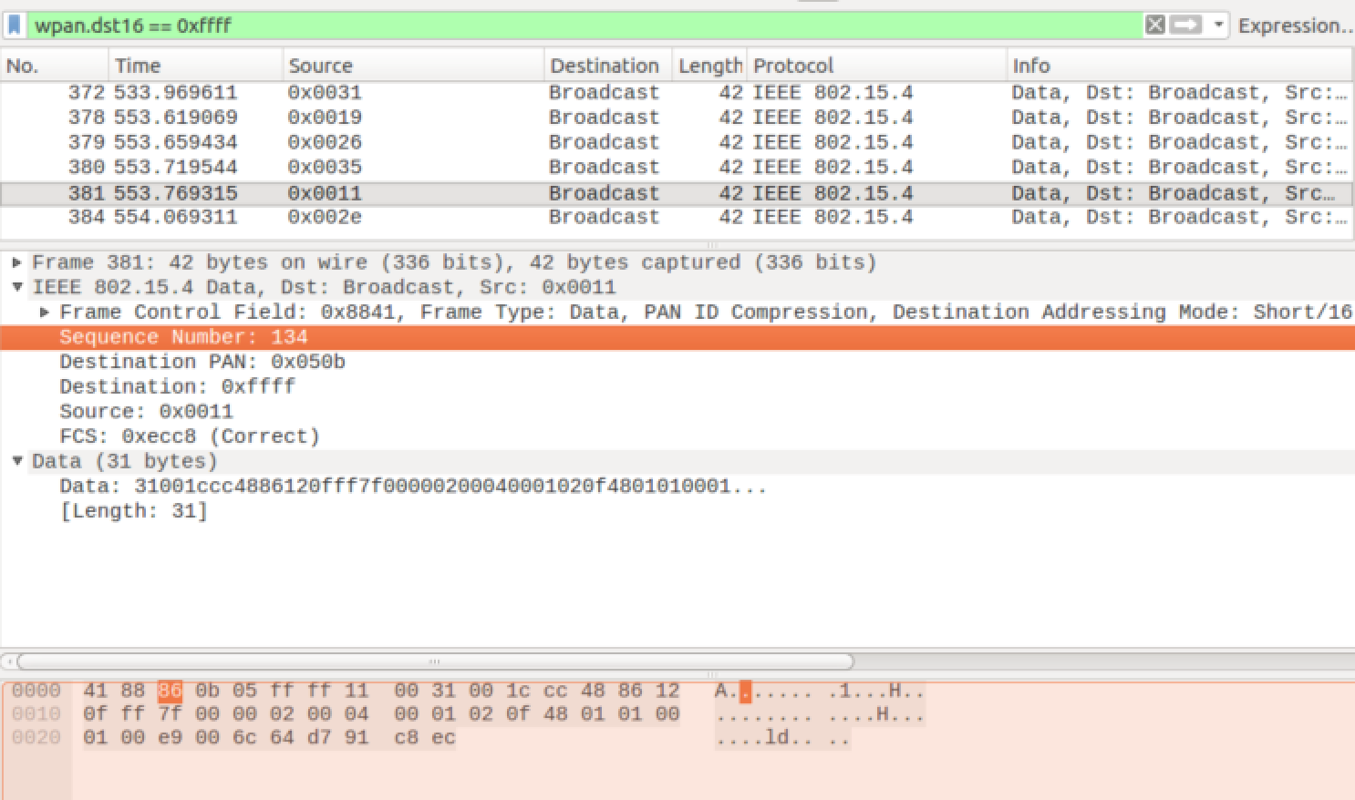
WirelessHART Link Layer Exhaustion
Complete with Wireshark connector!
Notes:
At this point periodic replay of fixed valid advertisement payload is possible

Slide 10
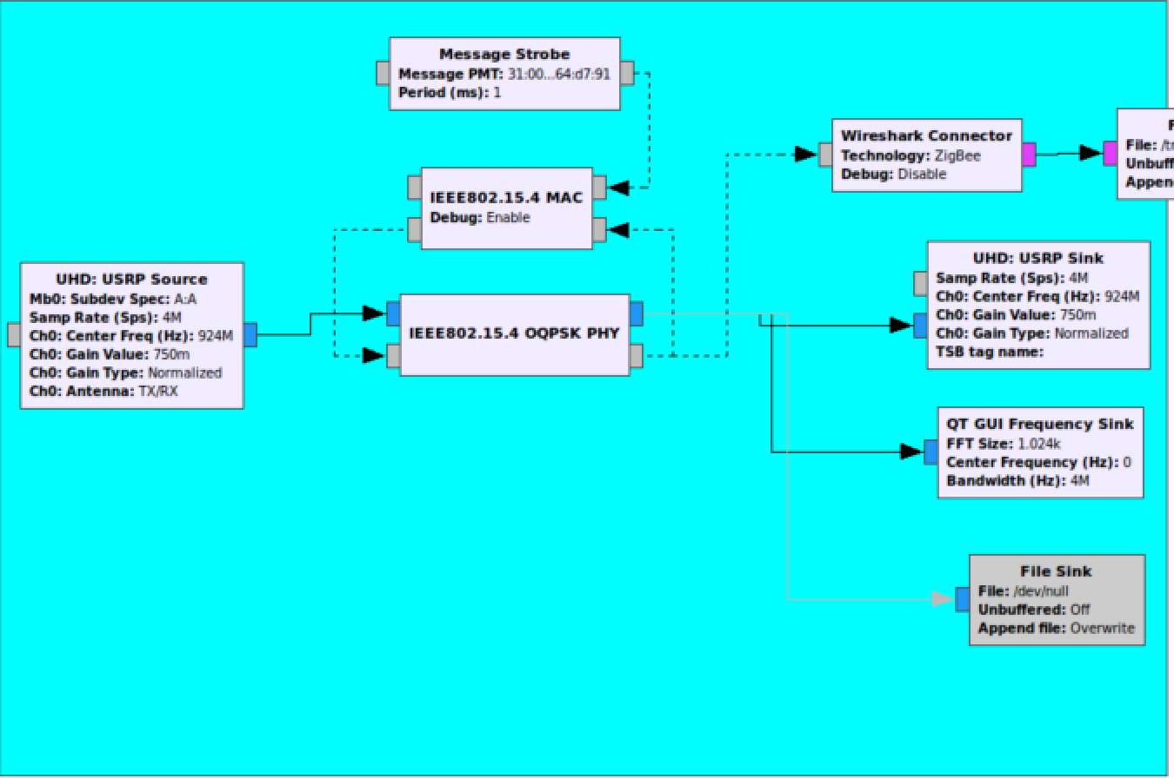
WirelessHART Link Layer Exhaustion
Virtual carrier-sensing is not referenced in the standard
Rely instead on continuous duty cycle relay during the CAP
Net ~50% duty cycle

Slide 11
WirelessHART Link Layer Exhaustion
Impact: Command frames cannot be passed over the mesh
New endpoints cannot join the mesh as legitimate advertisements cannot propagate
Notes:
So what Blake – these are industrial networks, things don’t change that often

Slide 12

WirelessHART Link Layer Exhaustion
Notes:
BUT WAIT, THERE’S MORE

Slide 13
WirelessHART Link Layer Exhaustion
Impact: Command frames cannot be passed over the mesh
Advertisements are only one type of command frame
Keep Alive PDU’s maintain the TDMA GTS synchronization
Devices will start dropping from the mesh as soon as 30 seconds after CAP is exhausted
Effects entire mesh even if attacker can only communicate with one node
Notes:
Effective mesh-wide brown out
Physical access controls are your only hope, but remember, attacker might not care about FCC power limits, and only needs to interact with one mesh member to take down the whole mesh

Slide 14
Application to Industrial Protocols – Future Work
ISA100.11a
Since starting this work I have not had an ISA100.11a implementation available to test on
Relies on the same 802.15.4 PHY CSMA that makes the Brodsky (2009) attack possible
Mesh link layer exhaustion requires some method of propagating unauthenticated frames
Similar to Wi-SUN stack currently being deployed widely for AMI
Notes:
Future work

Slide 15
Thank you.
Questions?

Slide 16
References
A Comparison of WirelessHART™ and ISA100.11a - Emerson Process Management 2012
Characterizing, Contextualizing, and Applying Wireless Attack Methods - Knight and Newlin 2017
gr-ieee802.15.4 - Bastian Bloessl – 2017
SmartMesh WirelessHART User's Guide - Linear Technology 2015
ANSI/IEEE 802.15.4-2006 - IEEE 2006
The S4 Papers - Digital Bond 2009

